Slide 1
ENTSO-E Paper on Market Design Options for Congestion Management
MESC | 9 October 2026

Slide 2
ENTSO-E Paper on Market Design Options for Congestion Management Study approach
Root causes
Slow and insufficient grid development
Increasing gap between market outcomes & physics
Key Challenges
Increasing congestions and associated costs
Integration of new renewables capacities and
flexibilities
Shorter time to deal with higher variability and
uncertainty of congestion patterns
Risk of insufficient grid-serving (including balancing) system flexibility
Policy and market Participant dependencies
Complex Cross-Border Coordination
Effectiveness of relying on remedial actions to
implement the minimum 70 % rule
Find the publication on ENTSO-E website: ENTSO-E Position Paper on Market Design Options

Slide 3
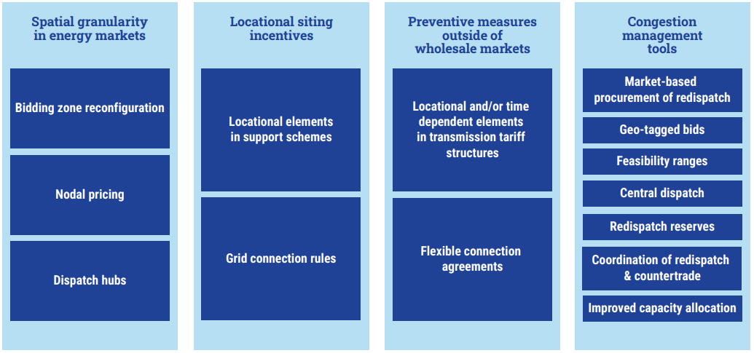
ENTSO-E Paper on Market Design Options for Congestion Management Overview of market design solutions
Locational elements in Capacity Mechanisms, RES & Flex Support Schemes
Find the publication on ENTSO-E website: ENTSO-E Position Paper on Market Design Options

Slide 4
ENTSO-E Paper on Market Design Options for Congestion Management Evaluation criteria for market design solutions
Evaluation Criterion (EC) | What it captures
EC1 – Dispatch and congestion management efficiency | Costs and volumes of redispatch/countertrade; balancing impacts; socio-economic effects; efficient use of transmission capacity; quality of price signals for flexibility.
EC2 – Operational security | Effectiveness in relieving congestion; robustness under uncertainty; remaining complexity for operations; impact on need for corrective measures after markets.
EC3 – Investment efficiency (long-term power system impacts) | Long-term siting and co-location signals; impacts on grid development needs; effects on WACC/investment risk; interaction with support schemes.
EC4 – Market impacts | Impacts on liquidity and transaction costs across DA/ID/BAL/forwards; affordability and distributional effects; harmonisation vs national flexibility; cross-border effects.
EC5 – Transition & implementation challenges | Legal, technical and organisational efforts; implementation time & costs for TSOs and market parties; acceptability; robustness to future system evolution.

Slide 5
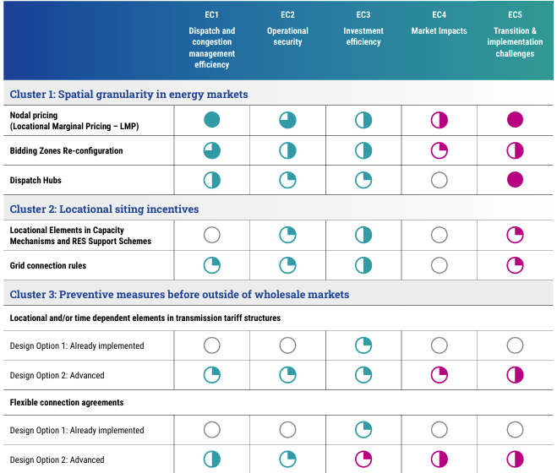
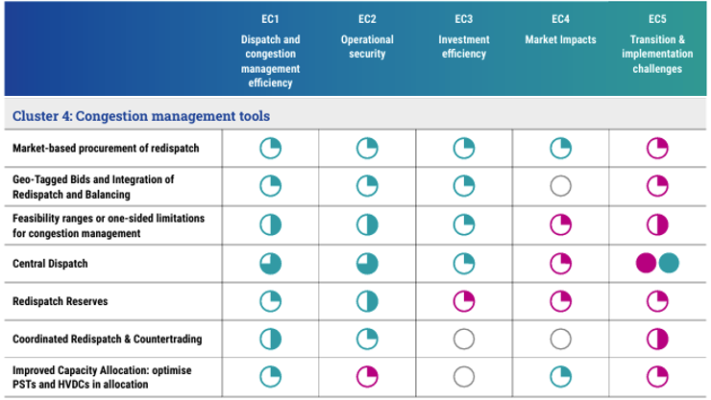
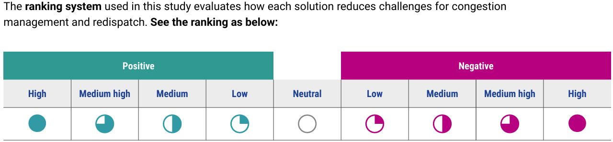
ENTSO-E Paper on Market Design Options for Congestion Management Overview of evaluations

Slide 6
ENTSO-E Paper on Market Design Options for Congestion Management Possible system-specific policy pathways
1. Systems with predictable Internal
Congestion addressed via finer spatial granularity
2. Highly Interconnected Congestion Systems
3. Limited-Interconnection Systems with Variable Congestion
For each archetype, a set of possible solutions is presented to address the underlying congestion challenges.
Internal Bidding Zones and Self-dispatch
New Internal Bidding Zones
Preventive congestion management before intraday gate closure in self-dispatch framework
Internal Bidding Zones and Central Dispatch
Without Bidding Zone Reconfiguration
Preventive congestion management before intraday gate closure in central dispatch framework
From Internal Bidding Zones to Nodal Pricing
Preventive congestion management after Intraday gate closure combined with proactive investment signals

Slide 7
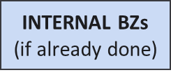
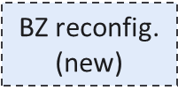
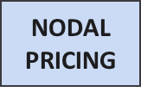
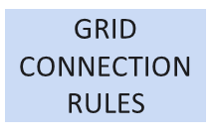
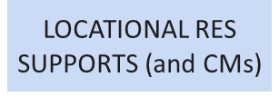
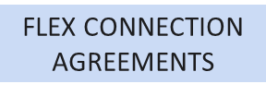
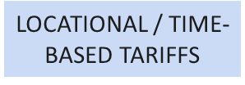
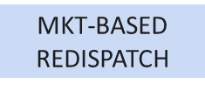
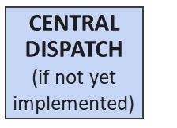
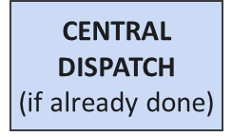
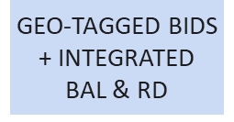
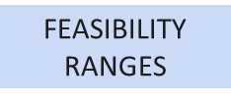
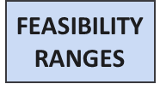
ENTSO-E Paper on Market Design Options for Congestion Management Archetype 1: Systems with predictable Internal Congestion addressed via finer spatial granularity
Systems in this archetype experience long-term stable & predictable congestions, mainly within their own grid. These congestions are primarily addressed through finer spatial granularity such as internal Bidding Zones
Possible Policy pathways for Archetype 1
Internal BZs + Self-dispatch
Internal BZs + Central Dispatch
From Internal BZs to Nodal Pricing
Spatial granularity
Locational siting incentives
Preventive measures outside wholesale markets
Congestion mgmt.
tools
Short-term
Mid-term
Long-term
Short-term
Mid-term
Long-term
Short-term
Mid-term
Long-term

Slide 8
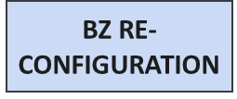
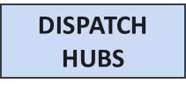
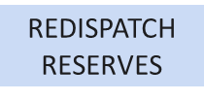
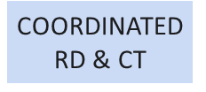
ENTSO-E Paper on Market Design Options for Congestion Management Archetype 2: Highly Interconnected Congestion Systems
These highly interconnected systems are significantly impacted by XZ interactions, such as loop flows. Congestions are generally long term but shaped by both domestic & neighbouring grid conditions, making coordination across BZ essential. Increasing variability & uncertainty leads to more volatile short-term congestion, requiring more frequent, near real-time interventions.
Possible Policy pathways for Archetype 2
New Internal Bidding Zones
Without BZ Reconfiguration
From Internal BZs to Nodal Pricing
Spatial granularity
Locational siting incentives
Preventive measures outside wholesale mkts
Congestion mgmt.
tools
Short-term
Mid-term
Long-term
Short-term
Mid-term
Long-term
Short-term
Mid-term
Long-term

Slide 9
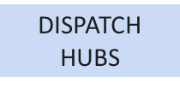

ENTSO-E Paper on Market Design Options for Congestion Management Archetype 3: Limited-Interconnection Systems with variable congestions
In these systems with limited interconnection capacity, congestions are mostly internal and variable rather than structurally stable. Temporary congestions in this archetype do not require modifications in terms of spatial resolution of energy markets. Instead, congestion management often relies on operational tools and preventive approaches, supported by targeted investment signals.
Possible Policy pathways for Archetype 3
Preventive Congestion Mgmt before ID GCT + self-dispatch
Preventive Congestion Mgmt before ID GCT + central dispatch
Preventive Congestion Mgmt after ID GCT + proactive investment signals
Spatial granularity
Locational siting incentives
Preventive measures outside wholesale mkts
Congestion mgmt.
tools
Short-term
Mid-term
Long-term
Short-term
Mid-term
Long-term
Short-term
Mid-term
Long-term

Slide 10
ENTSO-E Paper on Market Design Options for Congestion Management Policy Recommendations – 1/3
General
To ensure system security in a cost-efficient manner, policy makers should enable solutions to bridge the gap between markets and physics. Such solutions should aim at maximising trading opportunities for a truly integrated internal electricity market , but respect technical and operational limits as a priority. One current limitation to aligning physics & markets is the use of virtual margins in capacity calculation processes, as these carry significant collateral consequences for system operations. In current regulation virtual margins are a key feature of the min.70% framework. The principle behind the 70% framework (achieve market integration & avoid undue discrimination between internal and cross-zonal exchanges), remains fundamental. However, alternative ways of aligning market and should be explored.
Spatial granularity in energy markets
Recognise increased spatial granularity as a structurally effective long-term solution from congestion minimisation perspective, while acknowledging market impact together with implementation challenges and political implications. Consider context and region-specific pathways (e.g. bidding zone reconfiguration and/or dispatch hubs or potentially even nodal pricing, where proven to be feasible and efficient) depending on the significance and variability of the structural congestions, while ensuring internal electricity market efficiency. Ensure that any increase in spatial granularity addresses market parties’ needs of liquidity, risk hedging and investment certainty. Balance the need for periodic assessment/update of spatial granularity with predictability and stability for market participants (i.e. avoid too frequent or unpredictable reconfiguration).

Slide 11
ENTSO-E Paper on Market Design Options for Congestion Management Policy Recommendations – 2/3
Locational siting incentives
Where appropriate, integrate locational elements into capacity mechanisms, RES support schemes and flexibility support schemes where such schemes already exist. Consider using locational criteria in grid connections rules to steer new investments toward grid-supportive locations and to ensure that investment decisions reflect part of the congestion and redispatch costs they may impose on the system. Acknowledge that locational incentives are complementary instruments with primarily long-term effects and should not be expected to solve short-term congestion challenges. Ensure transparency, non-discrimination, cost-based design, and consistency with EU state aid and internal market principles.
Preventive measures outside of market clearing
Promote preventive measures that reduce redispatch volumes and uncertainty, while carefully balancing efficiency gains against forecast errors and implementation complexity. Consider flexible connection agreements as a tool in congested areas, with design choices (scope, timing, compensation, voluntariness) taking into account regulatory framework , system needs and market implications. In particular, the use of voluntary flexible connection agreements in congested areas should be expanded building on existing national experiences. Transmission and distribution tariffs can provide stable and transparent locational or time-dependent dispatch signals. More dynamic signals with locational elements should be carefully analysed to evaluate potential benefits against disadvantages. Ensure strong TSO–DSO coordination and clear communication to market participants to limit operational and behavioural risks.

Slide 12
ENTSO-E Paper on Market Design Options for Congestion Management Policy Recommendations – 3/3
Congestion management tools
Ensure the continued availability of timely, location-specific congestion management and redispatch resources to safeguard operational security under increasing uncertainty. Prefer market-based and integrated solutions (e.g. market-based redispatch, integration of balancing and redispatch) where sufficient liquidity and competition between service providers can be ensured, while recognising their limits depending on locational congestion patterns and carefully assessing overall market impacts. Apply intervention tools (e.g. redispatch reserves) only as targeted or temporary measures, not as permanent substitutes for less costly structural solutions. In systems where it’s already applied, leverage benefits of central dispatch approaches to balance market efficiency with the need to keep the system secure while optimising congestion management costs. Similarly, systems that apply or want to make use of the feasibility ranges concept should find an appropriate balance in their application. Continue improving cross-border coordination of redispatch and countertrade, including through regional operational frameworks, to minimise total system costs.

Slide 13
ENTSO-E Paper on Market Design Options for Congestion Management Concluding Messages
An energy transition at the lowest cost for consumers requires not only massive & timely grid investments but also better use of existing grids. Both operational evolutions (DLR, forecasts, PSTs, etc) and Market design solutions better reflecting physics are key to achieve this. Focus of our paper is the latter.
Different solutions exist: spatial granularity, locational siting incentives, preventive measures, Capacity Mechanism tools. As general principle, either the market design (and market participants) helps minimising or addressing congestions, or TSOs will need more tools (or preventive measures) for congestion management.
No one-size fits all, as countries have different grid topologies/generation mix/demand and measures have different trade-offs which policy makers should be allowed to choose [as they may favour certain national policy objectives or group of stakeholders over others]
However, it's essential to identify coherent policy pathways combining solutions that can work efficiently together, while also preserving overall IEM efficiency.
Many of the measures identified can be already implemented at national level, while others may require legislative adjustments [e.g. 70%]

